Slide 1

1. GSEA & GSVA
2. dNet
林丹 2017-12

Slide 2
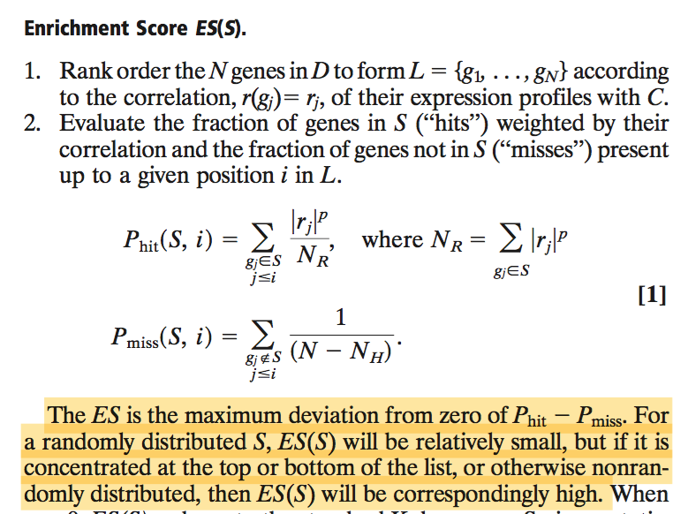
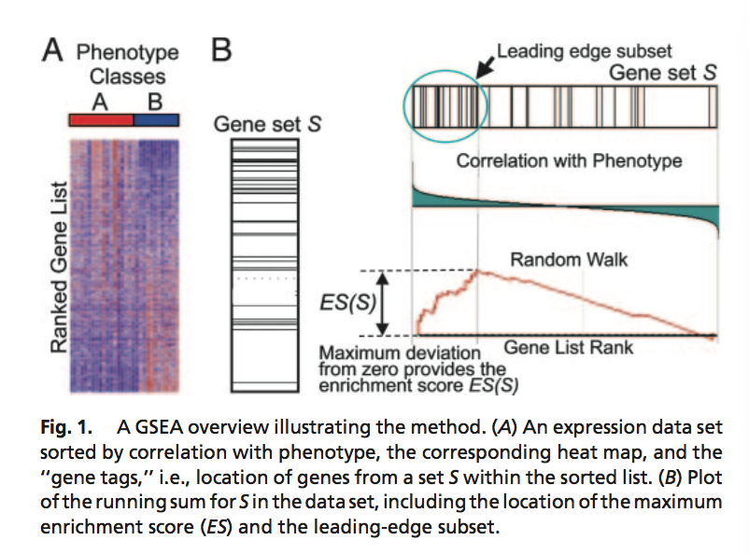
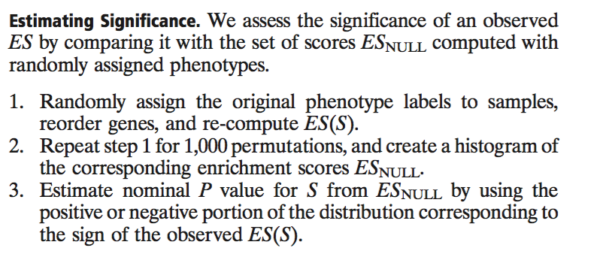
GSEA-gene set enrichment analysis
Notes:
GSEA features a number of advantages when compared with single-gene methods. First, it eases the interpretation of a large- scale experiment by identifying pathways and processes. Rather than focus on high scoring genes (which can be poorly annotated and may not be reproducible), researchers can focus on gene sets, which tend to be more reproducible and more interpretable. Second, when the members of a gene set exhibit strong cross- correlation, GSEA can boost the signal-to-noise ratio and make it possible to detect modest changes in individual genes. Third, the leading-edge analysis can help define gene subsets to elucidate the results.
The Leading-Edge Subset. Gene sets can be defined by using a variety of methods, but not all of the members of a gene set will typically participate in a biological process. Often it is useful to extract the core members of high scoring gene sets that contribute to the ES. We define the leading-edge subset to be those genes in the gene set S that appear in the ranked list L at, or before, the point where the running sum reaches its maximum deviation from zero (Fig. 1B). The leading-edge subset can be interpreted as the core of a gene set that accounts for the enrichment signal.
Examination of the leading-edge subset can reveal a biologically important subset within a gene set as we show below in our analysis of P53 status in cancer cell lines. This approach is especially useful with manually curated gene sets, which may represent an amal- gamation of interacting processes. We first observed this effect in our previous study (4) where we manually identified two high scoring sets, a curated pathway and a computationally derived cluster, which shared a large subset of genes later confirmed to be a key regulon altered in human diabetes.
High scoring gene sets can be grouped on the basis of leading- edge subsets of genes that they share. Such groupings can reveal which of those gene sets correspond to the same biological pro- cesses and which represent distinct processes.
The GSEA-P software package includes tools for examining and clustering leading-edge subsets (Supporting Text).

Slide 3
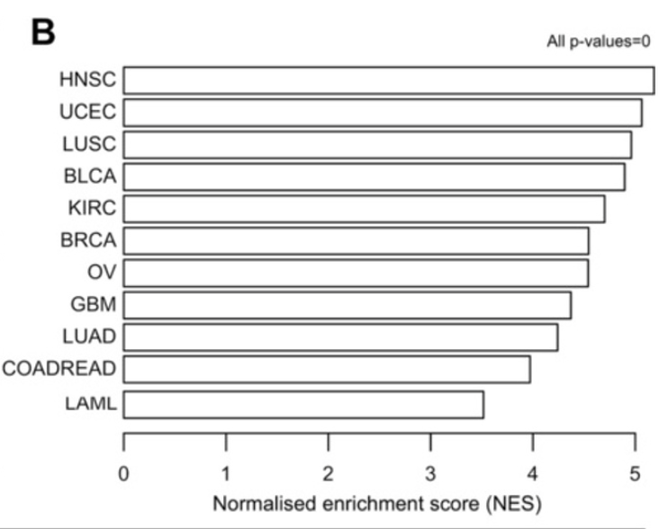
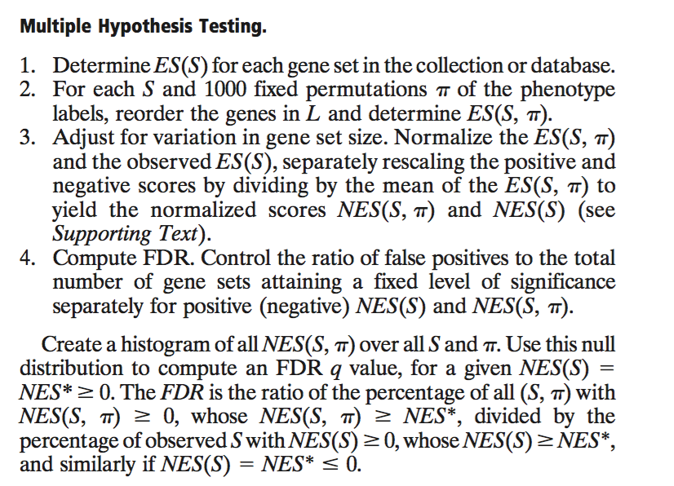
GSEA-gene set enrichment analysis
Notes:
Step 3: Adjustment for Multiple Hypothesis Testing. When an entire database of gene sets is evaluated, we adjust the estimated signif-
icance level to account for multiple hypothesis testing. We first normalize the ES for each gene set to account for the size of the set, yielding a normalized enrichment score (NES). We then control the proportion of false positives by calculating the false discovery rate (FDR) (8, 9) corresponding to each NES. The FDR is the estimated probability that a set with a given NES represents a false positive finding; it is computed by comparing the tails of the observed and null distributions for the NES.
Adjusting for Variation in Gene Set Size. As described in Appendix, when adjusting for variation in gene set size, we normalize the ES(S, π) for a given S, separately rescaling the positive and negative scores by dividing by their mean value, yielding NES(S, π) and NES(S) (normalized scores, NES).

Slide 4
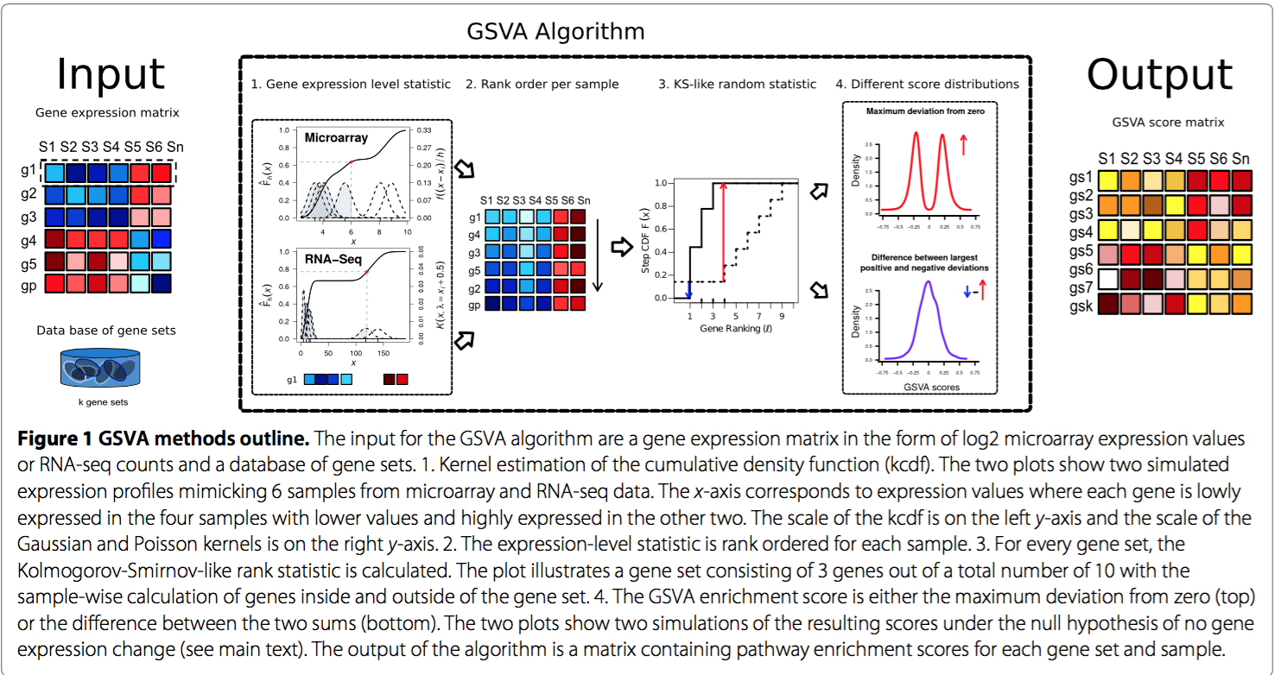
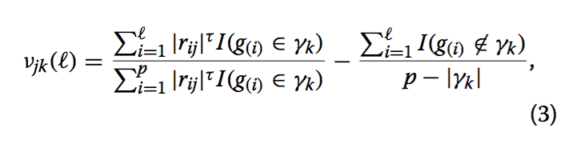
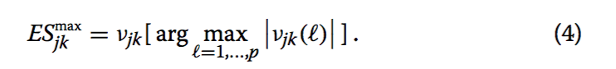
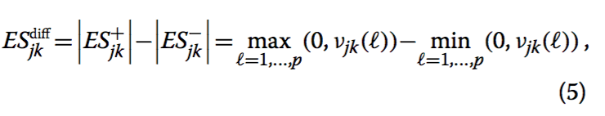
GSVA-gene set variation analysis
Example：/WORK/Cancer/lindan/R-D/GSVA/work.sh
Notes:
ESdiff :where ES+ and ES− are the largest positive and negative random walk deviations from zero, respectively, for sam- ple j and gene set k. This statistic may be compared to the Kuiper test statistic [29], which sums the maximum and minimum deviations to make the test statistic more sensitive in the tails. In contrast, our test statistic penal- izes deviations that are large in both tails, and provides a “normalization” of the enrichment score by subtracting potential noise. There is a clear biological interpretation of this statistic, it emphasizes genes in pathways that are concordantly activated in one direction only, either over-expressed or under-expressed relative to the overall population. For pathways containing genes strongly acting in both directions, the deviations will cancel each other out and show little or no enrichment. Because this statis- tic is unimodal and approximately normal (as observed via simulation, see below), downstream analyses which may impose distributional assumptions on the data are thus possible. In certain cases, the characteristics of this statistic may be undesirable, especially if the relevant gene sets are not explicitly separated into “up” and “down” behavior (as the MSigDB provides for many gene sets). In such circumstances, the statistic defined by Eq. 4 should be used.

Slide 5
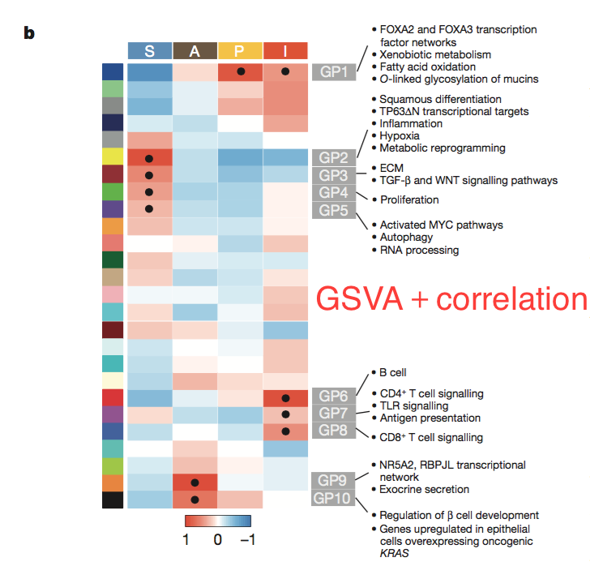
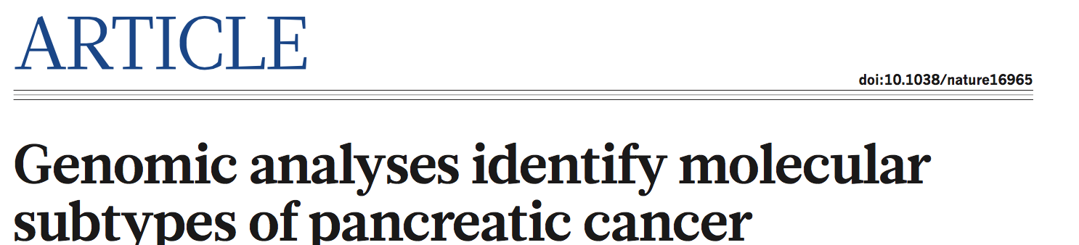
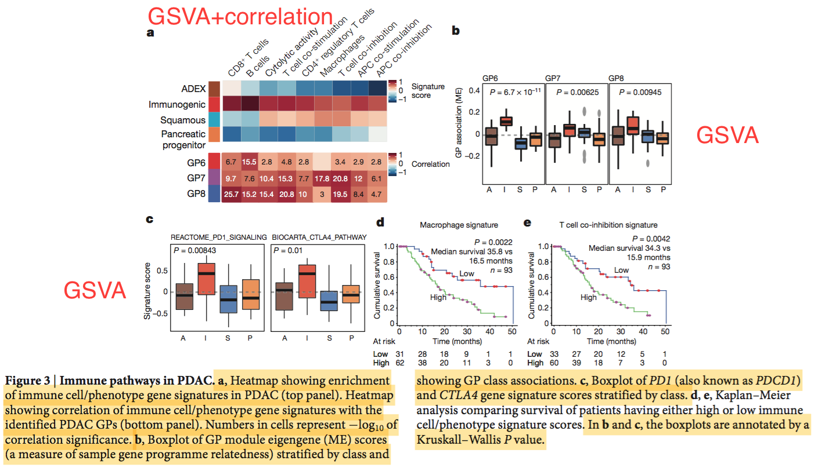
GSVA-gene set variation analysis
Notes:
WGCNA. Weighted gene co-expression network analysis (WGCNA) was used to generate a transcriptional network from the normalized and transformed RSEM44. Brief ly, WGCNA clusters genes into network modules using a topological overlap measure (TOM). The TOM is a highly robust measure of network interconnect- edness and essentially provides a measure of the connection strength between two adjacent genes and all other genes in a network. Genes are clustered using 1-TOM as the distance measure and gene modules are defined as branches of the resulting cluster tree using a dynamic branch-cutting algorithm45.
The module eigengene is used as a measure of module expression in a given sample and is defined as the first principle component of a module. To relate sam- ple traits of interest to gene modules, sample traits were correlated to module eigengenes and significance determined by a Student asymptotic P value for the given correlations. For gene module survival analyses, module eigengenes were stratified into quantiles (for example, lower 33% or upper 66% of values). To relate gene modules to PDAC classes, PDAC class gene set GSVA enrichment scores were used as sample traits and correlated with the module eigengenes as discussed above. Similarly, to relate the immune cell-type expression markers and immune meta- genes to the gene modules each immune GSVA enrichment score was correlated with the module eigengenes as before.

Slide 6
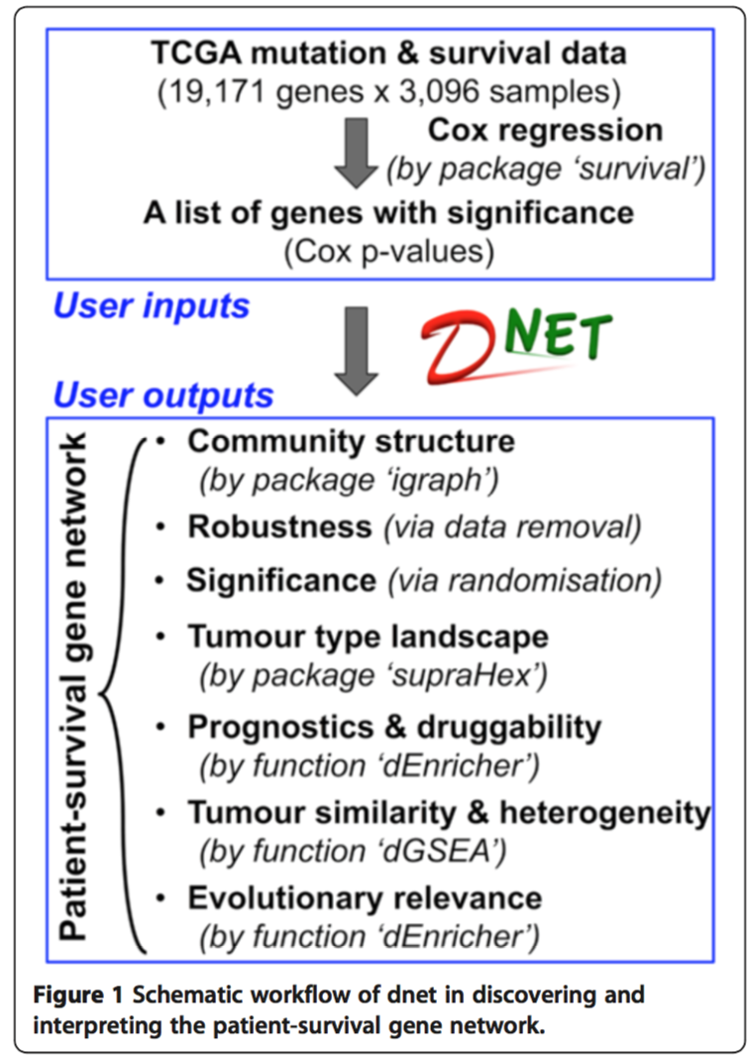

dNet
Dnet pipeline流程
dNet demo网址:
http://supfam.org/dnet/demo-TCGA.html
Notes:
1. 导入输入数据集矩阵：来自12个癌种的19,171个基因在3,096个癌症病人样本中的体细胞突变数量分布矩阵、3,096个癌症病人样本的临床表型信息（包括生存期信息、肿瘤原发位置信息、肿瘤类型信息等），该数据已经被整合到TCGA_mutations数据集中，通过library("Biobase")导入。
2. 通过Cox regression生存相关性分析 ( ‘survival’包)对19,171个基因的生存期相关性进行预测，得到每个基因的Cox HR值(生存期相关性)和Cox P values(生存期相关性显著性)。
3. 基于每个基因的基因名称和生存相关显著性P值(Cox P values)，从已有蛋白互作网络(STRING)中获得生存期相关基因互作网络图(dNet包的dNetInduce函数和dNetPipeline函数)，即core-net生存基因集，并对core-net基因集进行了robust分析(via data removal)、significance分析(via randomisation)以及基因集内部的communities结构分析(‘igraph’包) 。
4. 基于core-net生存基因集对12个癌种之间的关系进行了概览，即根据core-net网络图的连接关系构建每条edge在不同类型肿瘤中的信息矩阵(edges × tumour)，通过dnet包的‘dNetReorder’函数(扩展自‘supraHex’包)将不同类型肿瘤之间的关系自组织到一张2D图中进行展示。
5. 对core-net生存基因集的生存期预测效力和药物基因富集情况(dnet包的‘dEnricher’函数：DGIdb ontology富集分析)进行了分析。
6. 对core-net生存基因集进行了多癌种突变频率高均一性基因富集程度、单癌种高突变频率基因富集、病人个体高突变基因富集程度的分析(dnet包的dGSEA, Gene Set Enrichment Analysis)，从生存期的角度揭示了肿瘤之间的相似性和肿瘤内部的异质性。
7. 对core-net生存基因集进行了进化溯源分析(dnet包的‘dEnricher’函数)。

Slide 7
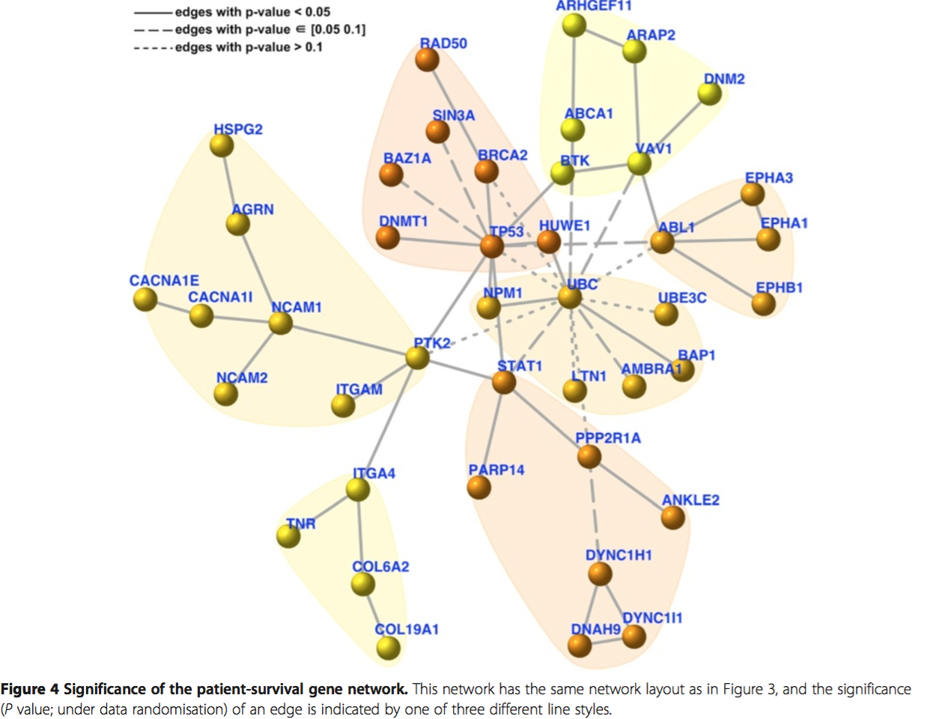
dNet
基于已有的基因列表（基因名称＋基因显著性P值，如生存相关性Cox p-values），从已有蛋白互作网络(STRING)获取到该列表基因的网络图，设定一个P值作为阈值，用dnet pipeline从该网络图中寻找到最大得分的subgraph，即得到dNet基因互作网络图(survival network, 称core-net生存基因集)。

Slide 8
dNet
Dnet构建core-net基因互作网络核心代码解读
<输入文件> 第一列基因名；第二列基因P值
# 从STRING database (version 10)数据库导入人类蛋白互作网络(igraph对象，该对象只保留了score>=400的连接关系)。
library(‘dnet’)
library(‘igraph’)
load("/PUBLIC/software/CANCER/Software/dNet/org.Hs.string.RData")
# 筛选保留score>=700的连接关系
network <- subgraph.edges(org.Hs.string, eids=E(org.Hs.string)[combined_score>=700])
#从network中分离出只包含P值列表基因的互作网络
ind <- match(V(network)$symbol, names(pvals))
nodes_mapped <- V(network)$name[!is.na(ind)]
network <- dNetInduce(g=network, nodes_query=nodes_mapped, knn=0, remove.loops=F, largest.comp=T)
V(network)$name <- V(network)$symbol
# 根据P的设定阈值得到最终需要的互作基因集-core-net
net <- dNetPipeline(g=network, pval=pvals, method="customised", significance.threshold=2.5e-02)

Slide 9
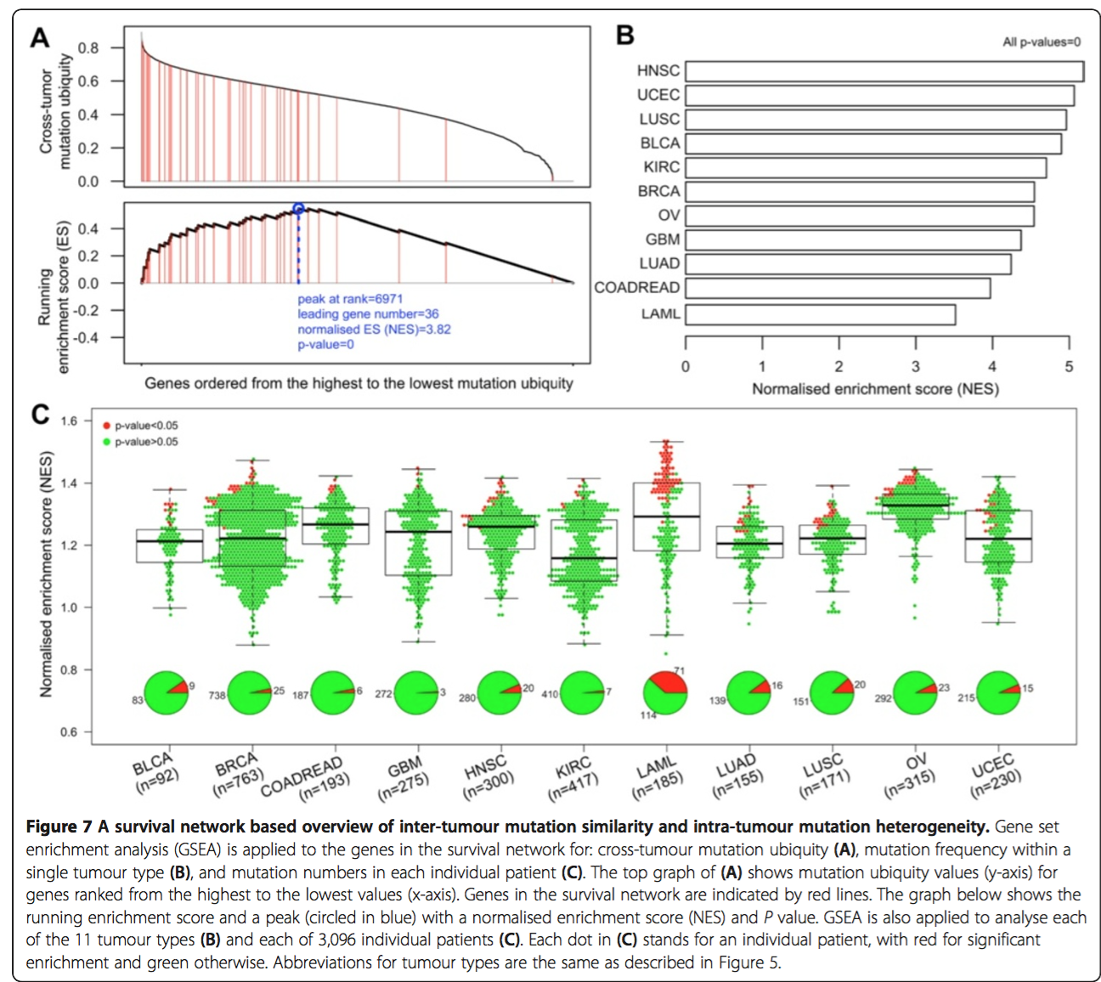
dNet -dGSEA
通过dNet的dGSEA对core-net生存基因集进行
A.多癌种突变频率均一性、
B.单癌种高突变频率、
C.病人个体高突变数目
三个不同指标的富集程度分析(Figure 7)。
Notes:
dnet包‘dGSEA’函数的应用总结和使用方法-GSEA分析
应用总结：
基因集富集分析 (Gene Set Enrichment Analysis, GSEA) 的基本思想是使用预定义的基因集（通常来自功能注释或先前实验的结果），将基因按照在两类样本中的差异表达程度排序，然后检验预先设定的基因集合是否在这个排序表的顶端或者底端富集。基因集合富集分析检测基因集合而不是单个基因的表达变化，因此可以包含这些细微的表达变化，预期得到更为理想的结果。从中可以看到GSEA分析有三个特点：(1)分析的基因集合而不是单个基因；(2)将基因与预定义的基因集进行比较；(3)富集分析。
GSEA的优势：以差异富集分析为例，一般的富集分析（如GO和Pathway分析）往往侧重于比较两组间的基因表达差异，集中关注少数几个显著上调或下调的基因，这容易遗漏部分差异表达不显著却有重要生物学意义的基因，忽略一些基因的生物特性、基因调控网络之间的关系及基因功能和意义等有价值的信息（http://www.360doc.com/content/16/1026/18/19913717_601568937.shtml ）。
使用方法：
eTerm <- dGSEA(data=rankdata, identity="symbol", genome="Hs", ontology="Customised", customised.genesets=geneset, weight=0, nperm=2000)
只要给定一个已排序的基因列表(rankdata：第一列基因名，第二列指标值；可以按照各种指标排序，如按照Cox HR值由高到低排好序的基因列表，或者按照多癌种频率发生普遍性u值由高到低排好序的基因列表，或者按照单癌种发生频率由高到低排好序的基因列表，或者按照单个病人突变数目由高到低排好序的基因列表，或者按照分组间差异表达程度由高到低排好序的基因列表……)，就可以基于该列表计算属于该列表任意基因集(geneset)相应指标的富集指数(NES, normalised enrichment score)。
dnet包‘dGSEA’函数的应用参考文献
Human primary liver cancer–derived organoid cultures for disease modeling and drug screening. Nature medicine 2017.通过对159个基因集进行GSEA分析，发现与肝癌的发生关联最大的基因集。
Broad研究所GSEA分析网址：http://software.broadinstitute.org/gsea/index.jsp (MsigDB: molecular signature database)
如图Figure 7A所示，core-net基因集的基因均呈现较高的u值，如图Figure 7B所示，core-net基因集在单个癌种中也呈现高频突变基因富集的趋势(共12个癌种)。相比之下，如Figure 7C所示，core-net基因集在单个肿瘤内部不同病人样本的高突变基因富集程度呈现高度的异质性(共12个癌种，3,096个病人样本)。
这些结果为解释肿瘤之间的相似性和肿瘤内部的异质性提供了新的分析维度：生存期相关。

Slide 10
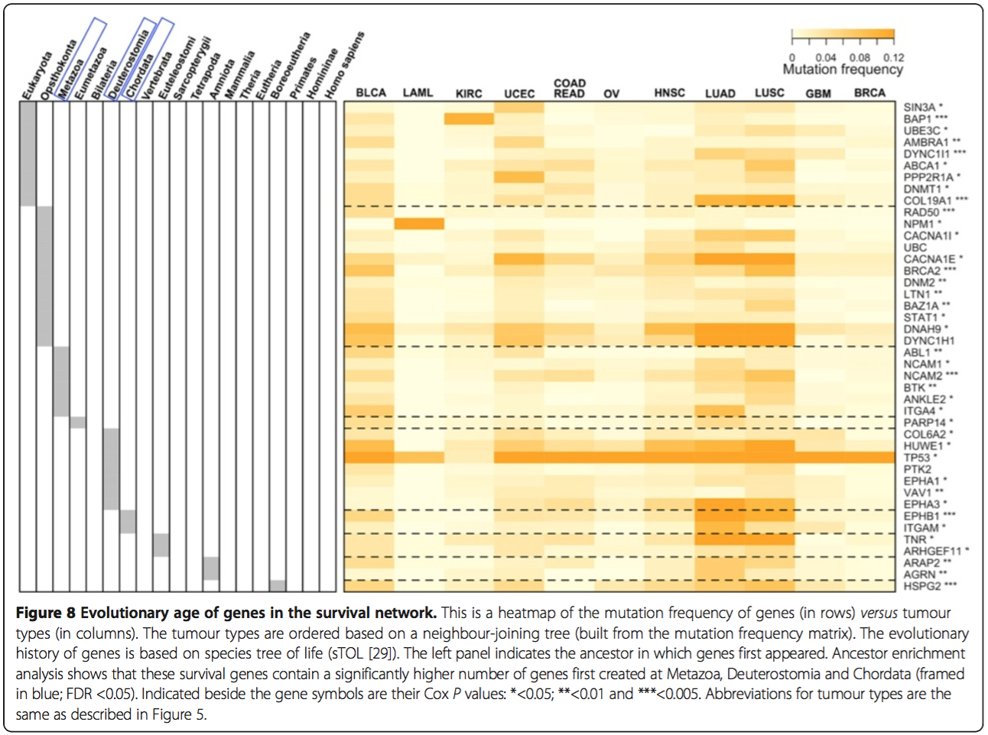
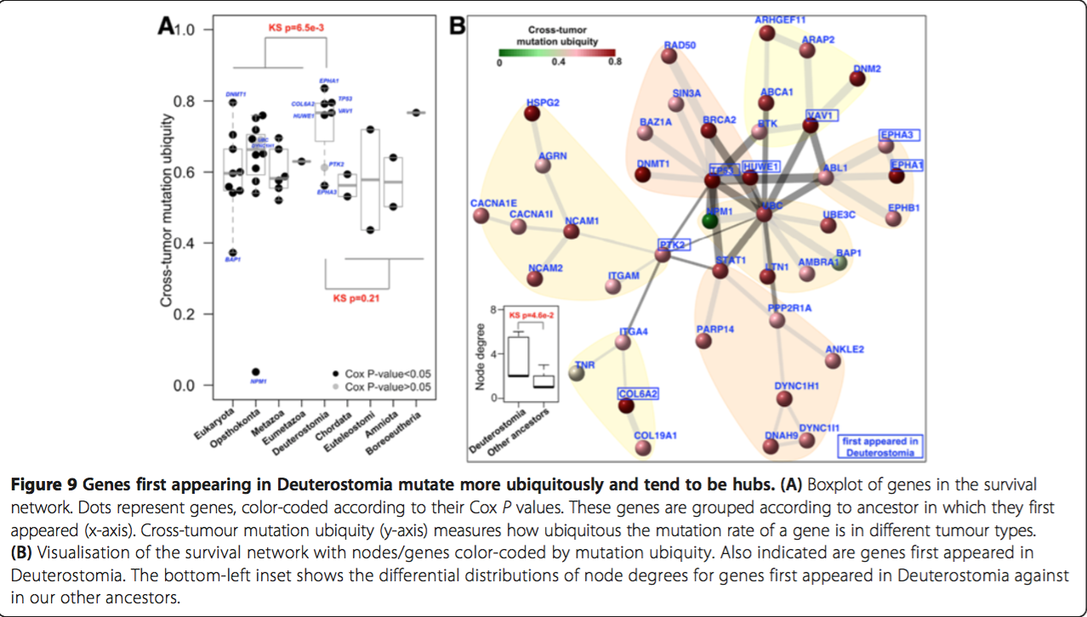
dNet -dEnricher
Notes:
dNet包dEnricher函数的使用方法
dEnricher is supposed to conduct enrichment analysis given the input data and the ontology in query. It returns an object of class "eTerm". Enrichment analysis is based on either Fisher’s exact test or Hypergeometric test. The test can respect the hierarchy of the ontology.
dEnricher函数用法：
以GOBP富集分析为例，V(net)$name表示基因集的基因名，"Hs"表示人类基因组，ontology="GOBP"表示使用GOBP ontology数据集，RData.location指定了GOBP ontology数据集所在的路径：
eTerm <- dEnricher(data=V(net)$name, identity="symbol", genome="Hs", ontology="GOBP", RData.location="/PUBLIC/software/CANCER/Software/dNet")
Metazoa(后生动物) Deuterostomia(新口动物)
core-net基因集进化相关性分析
由于core-net基因集控制着癌症病人的生存期，有必要对core-net基因集进行进化溯源。基于sTOL树进行core-net基因集的物种起源定位，某个基因第一次出现的祖先决定了该基因的年龄。分析发现，半数core-net基因创建于动物-真菌分界线(后鞭毛生物，Opisthokonta)或更早，65%的core-net基因创建于动物祖先- Metazoa(后生动物)或更早，高达83%的core-net基因创建于人类祖先-Deuterostomia(新口动物)或更早。为了检验每个生存基因的溯源时间不是随机的，以每个祖先的基因集为背景进行了富集分析，结果证明了生存基因出现时间的非随机性并且倾向首次创建于Metazoa, Deuterostomia 和 Chordata(脊索动物类)这三个祖先(FDR<0.05)。
通过Figure8同时对core-net基因的溯源祖先及其在各个癌种中的突变频率进行展示发现，起源于Deuterostomia的基因倾向于在各个癌种中具有突变频率均一性。为了验证这一发现，对不同溯源祖先包含的生存基因集进行肿瘤间突变频率均一性分析发现，起源于Deuterostomia的生存基因与起源于更早祖先的生存基因相比，在肿瘤间突变频率均一性的分布上存在显著差异(Figure 9A, KS tests; P = 6.5e-3)，并且起源于Deuterostomia的生存基因与起源于Deuterostomia之后祖先的生存基因相比，在肿瘤间突变频率均一性的分布上不存在显著差异(Figure 9A, KS tests; P = 0.21)。
Figure 9B 对生存基因的突变均一性、溯源祖先和连接度(degree)进行了全面展示，从中可以发现起源于Deuterostomia的基因和起源于其他祖先的基因的节点连接度显著不同。
之前的癌症基因进化溯源分析报导过Metazoa对于原癌基因和肿瘤抑癌基因出现的重要性，与本文研究相一致：许多癌症患者的生存基因首次创建于Metazoa。除此之外，本文研究发现更晚出现的Deuterostomia在塑造癌症患者生存期相关基因方面有重要进化意义。本文研究为癌症进化分析增加了一个新的视角：生存期相关。癌症生存期相关的基因在Metazoa之后持续出现在Deuterostomia中并非巧合。Deuterostomia以其决定细胞命运的可塑性著称，这一特性在Deuterostomi之前的祖先中未曾出现。对Deuterostomia具有这一特性最保守的解释：许多广泛影响细胞命运的高频突变基因首次在该物种中得到创建。创建于Deuterostomia的生存基因对癌症病人生存期有着重要的影响，一方面由于其广泛突变于多个不同细胞/癌种，另一方面由于其进化上的必要性。这些基因有一些得到了广泛研究，像TP53及其降解物HUWE1，蛋白­-酪氨酸激酶信号(EPHA1、EPHA3)，而其他基因像PTK2、VAV1则研究的较少，本研究揭示这些基因对癌症研究的意义远大于当前的认识。

Slide 11
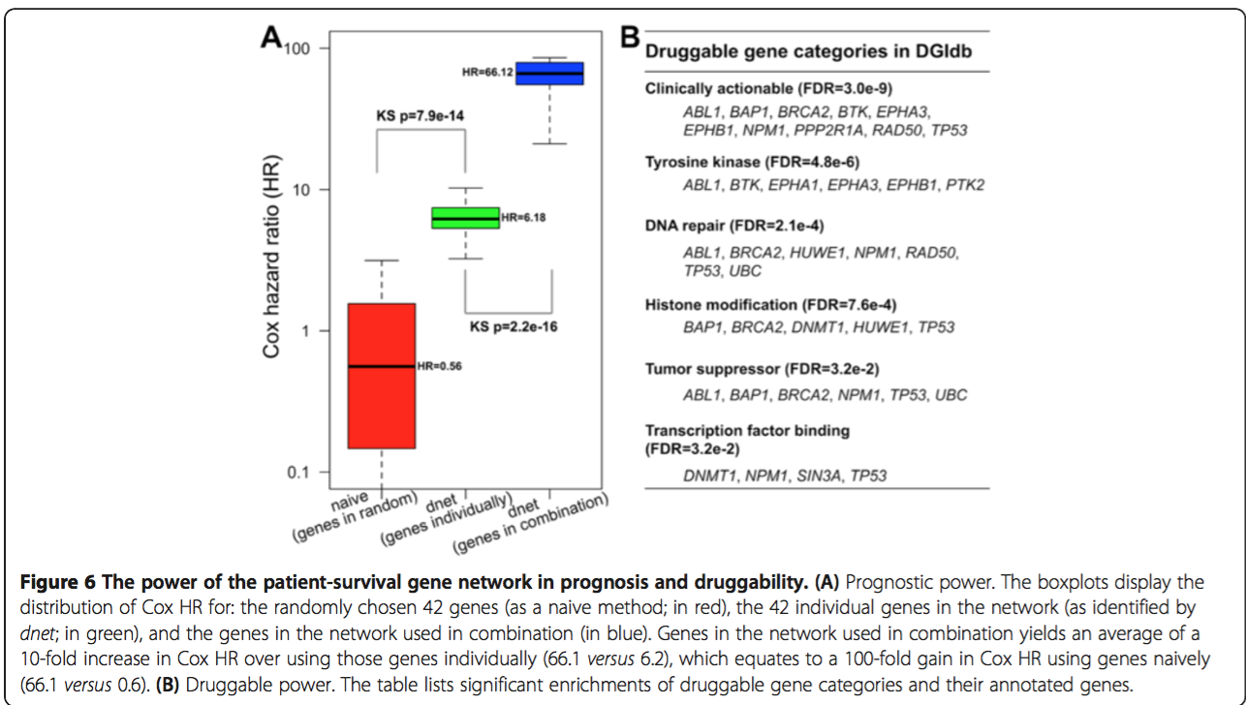
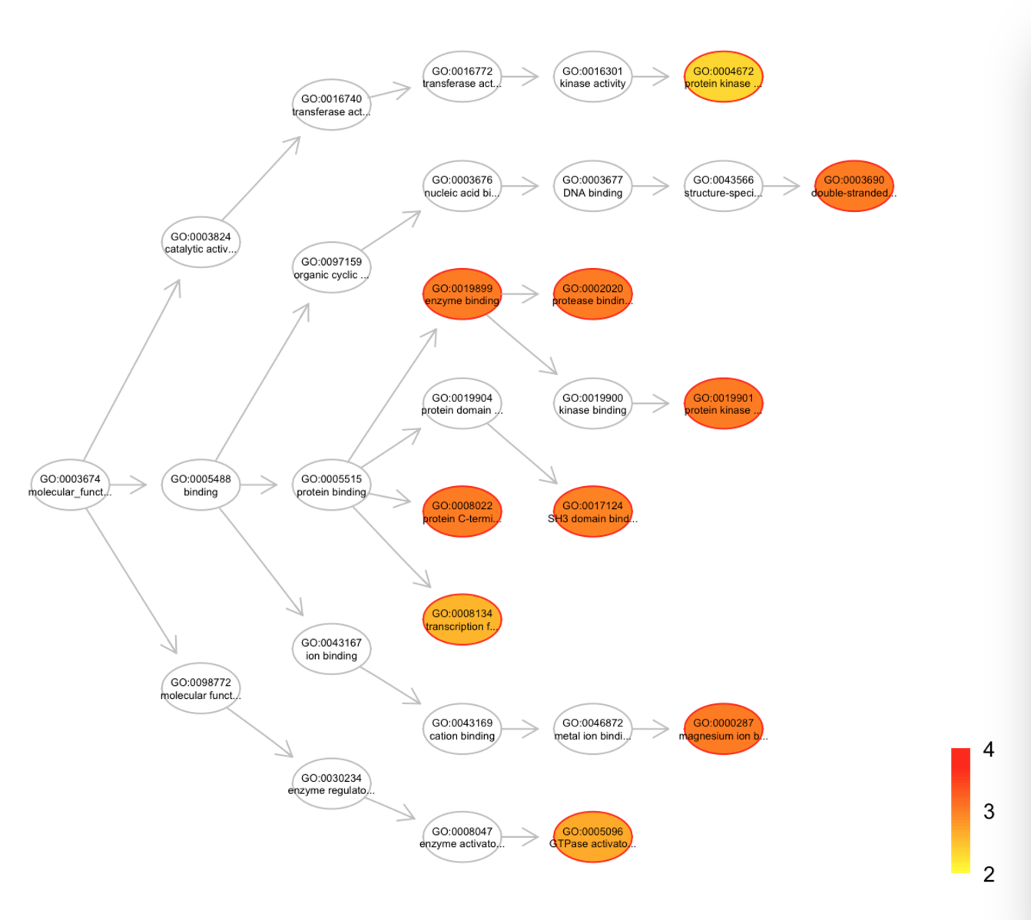
dNet -dEnricher
Notes:
除了DGIdb ontology(DGIdb 药物基因分类富集分析)、PS2 ontology(基因进化分析)外，dnet收录了许多其他ontologies，包括GOBP（GOBP 富集分析） 、GOMF(GOMF 富集分析)、MP(Mammalian_phenotype)、DO(Disease_Ontology)、MsigdbC2CP(通路富集分析-CP)、MsigdbC2KEGG(通路富集分析-KEGG)、MsigdbC2REACTOME(通路富集分析-REACTOME)、MsigdbC2BIOCARTA(通路富集分析-BIOCARTA)、SF(SCOP 超家族结构阈富集分析)等等。
以上数据集均已下载至集群路径：/PUBLIC/software/CANCER/Software/dNet.更多数据集可以去https://github.com/hfang-bristol/RDataCentre/blob/master/dnet/1.0.7/自行下载。
药物相关性预测
通过药物基因分类的富集情况，评估core-net生存基因集的药物相关性。通过基于富集分析的超几何分布(dnet的‘dEnricher’函数)，发现core-net富集的DGIdb药物基因分类(富集显著性：经过多重假设检验校正后的FDR≤0.05) 。如Figure 6B所示，top1富集的药物分类是‘Clinically actionable’分类。富集在‘Clinically actionable’分类的基因包括：编码酪氨酸激酶的基因(ABL1, BTK, EPHA3, EPHB1), 参与DNA修复的基因(ABL1, BRCA2, NPM1, RAD50, TP53), 组蛋白修饰基因(BAP1, BRCA2, TP53), 抑癌基因(ABL1, BAP1, BRCA2, NPM1, TP53)。这些说明core-net生存基因集具有临床应用的潜力。
除了基于多癌种进行core-net构建，也对单个癌种进行了core-net构建，12个癌种各自构建的core-net基因集数目不等，LAML最低，LUSC最高，与每个癌种的突变数量一致。对单癌种的core-net进行药物基因富集分析发现，大部分单癌种的core-net基因集与多癌种core-net基因集富集的药物分类相类似，但是不同癌种之间的core-net基因集组成差异很大，说明不同癌种的core-net基因集行使着某些共同的功能，同时暗示了研究不同癌种共性的可能性。

Slide 12
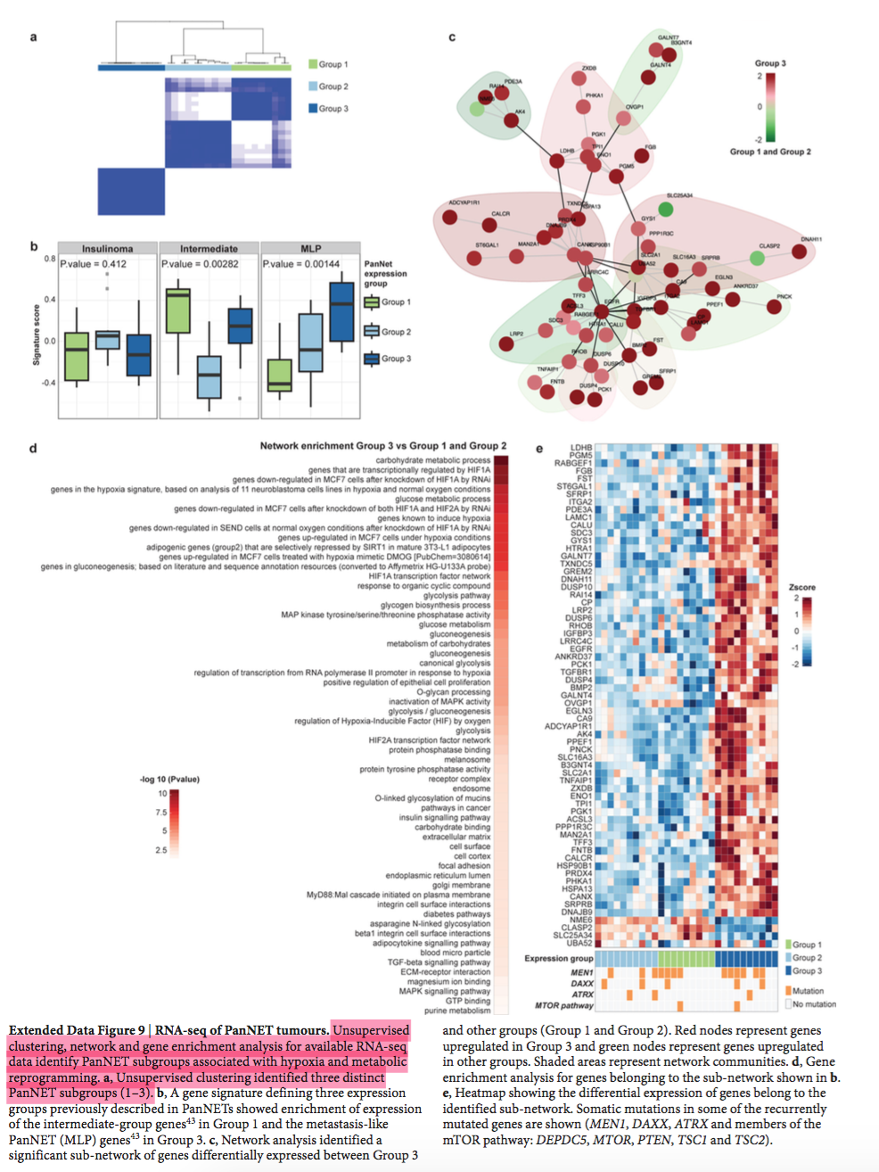
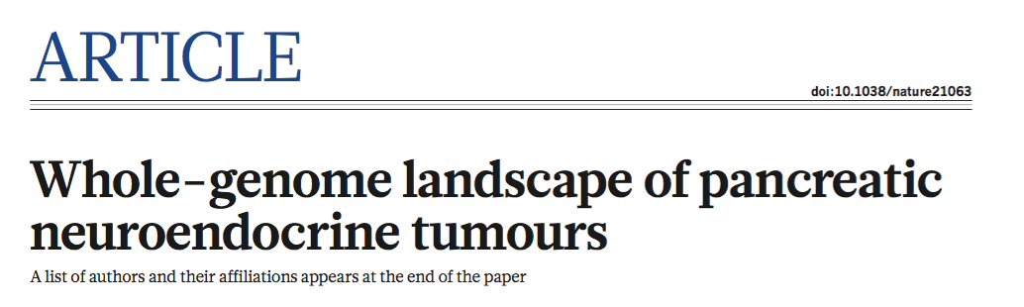
GSVA+dNet

Slide 13
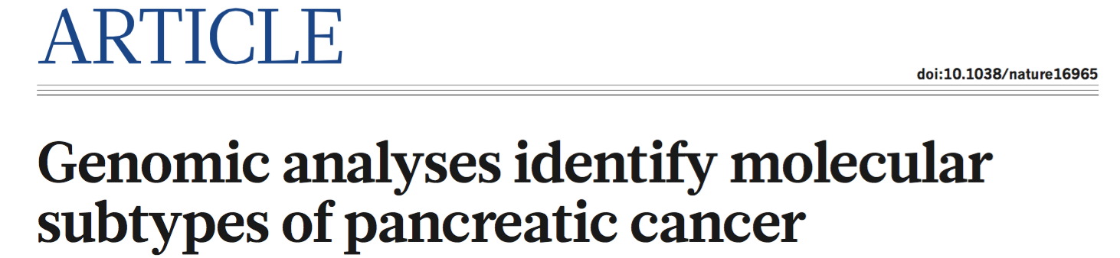
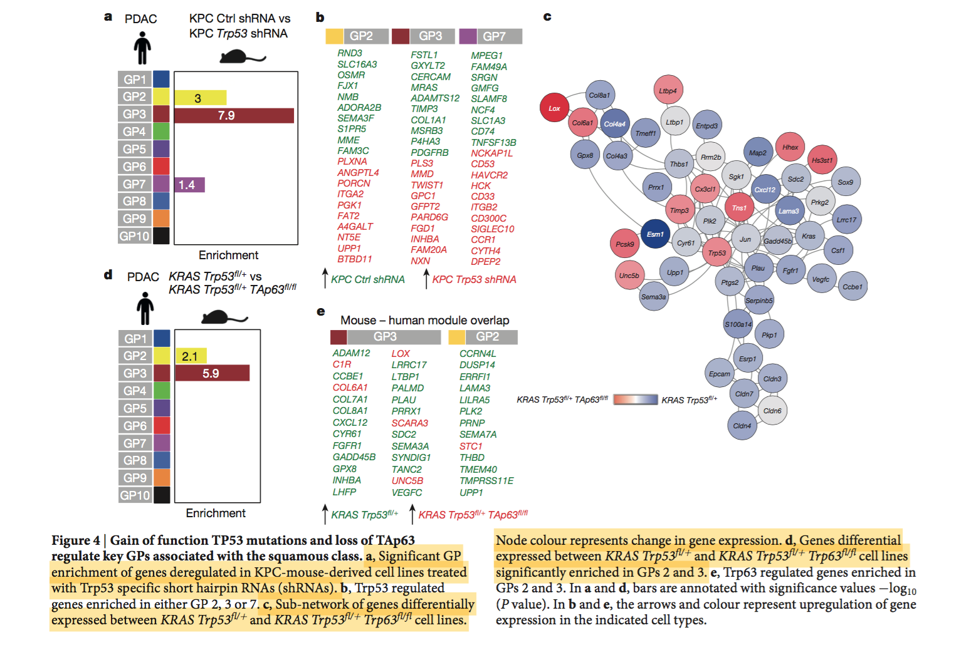
GSVA+dNet

Slide 14


